Slide 1
Anesthesia Monitoring and Equipment
Wosenyeleh A. (BSc, Msc)
AAU, Department Of Anaesthesia

Slide 2
Anesthesia Equipments
CONTENTS
Medical Gas supply
Anaesthetic machine
Breathing systems
Humidification and filtration
Airways
Tracheal intubation equipment
Masks and oxygen delivery devices
Ventilators

Slide 3
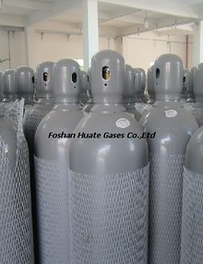
MEDICAL GAS SOURCES
This Photo by Unknown author is licensed under CC BY-SA.

Slide 4
Why learning medical gas?
As the anesthetist, you are responsible for what is administered to the patient.
In the UK, all anesthetists are responsible for the gas supply from the wall of the theatre to the patient.
In Ethiopia anesthetists may hold the most knowledge about gas supplies throughout the OR.
An understanding basic physical principles is required to understand the gas supply.

Slide 5
Medical gas supply
A brief overview of relevant gas physics
What is pressure?
A single molecule of O₂ moving within a box will bounce off the walls and will impart a force each time
Multiple molecules within the box will have lots impacts and will impart a higher average force
The force per unit area will be the same in all directions (on average).
The more molecules or the faster they move (hotter gas), the greater the average force.
Pressure = force
Generally, more molecules or hotter molecules increase the pressure
area

Slide 6
Medical gas supply
A brief overview of relevant gas physics (cont.)
N
N / m²
(Pa)
Pressure = force
area
m²
What is the relationship between pressure, temperature and volume?
As mentioned before, more molecules or hotter molecules give an increased pressure…
Universal gas constant
(8.314 J/mol/K)
Pressure (Pa)
PV = nRT
Absolute temperature (Kelvin)
Volume (m³)
Number of moles of gas
This is the “Universal Gas Law”

Slide 7
Medical gas supply
A brief overview of relevant gas physics (cont.)
The “Universal Gas Law”
PV = nRT
So;
doubling the volume of a fixed amount of gas
will halve the gas pressure
(at a constant temp)
doubling the pressure of a fixed amount of gas
will halve the gas volume
(at a constant temp)
doubling the temperature of a fixed amount of gas in a fixed volume
will double the gas pressure
doubling the temperature of a fixed amount of gas at a certain pressure
will double the volume

Slide 8
Medical gas supply
A brief overview of relevant gas physics (cont.)
The “Universal Gas Law” ; PV = nRT
A practical example:
A size E oxygen cylinder has 5 L of compressed O₂ at a pressure of 13700 kPa
What is the volume of O₂ at atmospheric pressure (101 kPa)?
Assuming the gas temperature is the same at start and finish;
P₁V ₁ = P₂V₂
So, V₂ = P₁V₁ / P₂
= 13700 kPa.V₁ / 101 kPa
= 135 X 5 L
≈ 680 L
the volume of O₂ expected from a full size E cylinder

Slide 9
Medical gas supply
A brief overview of relevant gas physics (cont.)
Different pressure scales
Atmospheric pressure
Atmospheric pressure
1 atm
1 Bar
101300 N / m2
101300 Pa
101.3 kPa
Atmospheric pressure supports a column of water (1033.2 cm) or mercury (760 mm)
Strong vacuum
760 mm Hg
1033 cm H₂O
14.7 PSI
(pounds per square inch (US))

Slide 10
Medical gas supply
A brief overview of relevant gas physics (cont.)
Reference table for different pressure scales
1 Bar
1 kPa
1 mm Hg
in Bar
1
in kPa
101.3
1
in mm Hg
760
7.50
1
in cm H₂O
1033
10.19
1.36
(=1 atm)
(=1000 Pa)
(=1 Torr)

Slide 11
Main Gases used in anaesthesia
Essential for almost all general anaesthesia; physiological changes during GA mean patient requires higher FiO₂
Oxygen
Air
Preferable to avoid excessive FiO₂ (fractional inspired oxygen) if possible (requires judgment) ➔ excessive FiO₂ causes lung damage and decreases post-operative respiratory function
N₂O
Variable use by anaesthesiologists. Used particularly for smooth gas inductions and for intra-operative analgesia by some.

Slide 12
Medical gas sources
Cylinders
Oxygen piping system and
Oxygen concentrator

Slide 13
How are they supplied?
Oxygen
Cylinders in theatre
Cylinder manifold (piped to theatre)
Oxygen concentrator
Piped to theatre
To fill cylinders
Directly at bedside
Vacuum insulated evaporator (piped to theatre)
Cylinders in theatre
Directly from air compressor (via wall pipes)
Air
Cylinders in theatre
Cylinder manifold (piped to theatre)
N₂O

Slide 14
Types of compressed Gas
Non-liquefied Compressed Gas
Gas that does not liquefy at ordinary temperatures regardless of the pressure applied.
Examples include O2, N, Air, and He.
Liquids at very low temperatures (cryogenic liquids)
Liquefied Compressed Gas
Gas that becomes liquid to a large extent in containers at ambient temperature and at pressures from 25 to 1500 psig.
Examples include N2O & CO2.

Slide 15
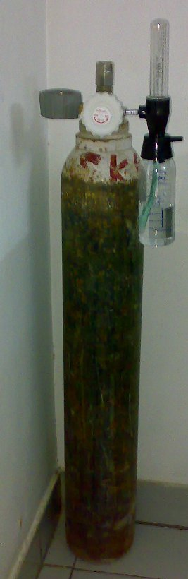
Oxygen Cylinders

Slide 16
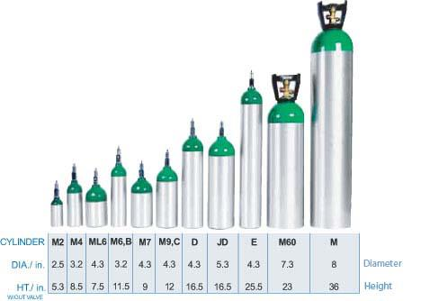
Although there are several types of o2 cylinders, There are two types which are common.
E-cylinders
H-cylinders
This Photo by Unknown author is licensed under CC BY-NC-ND.

Slide 17
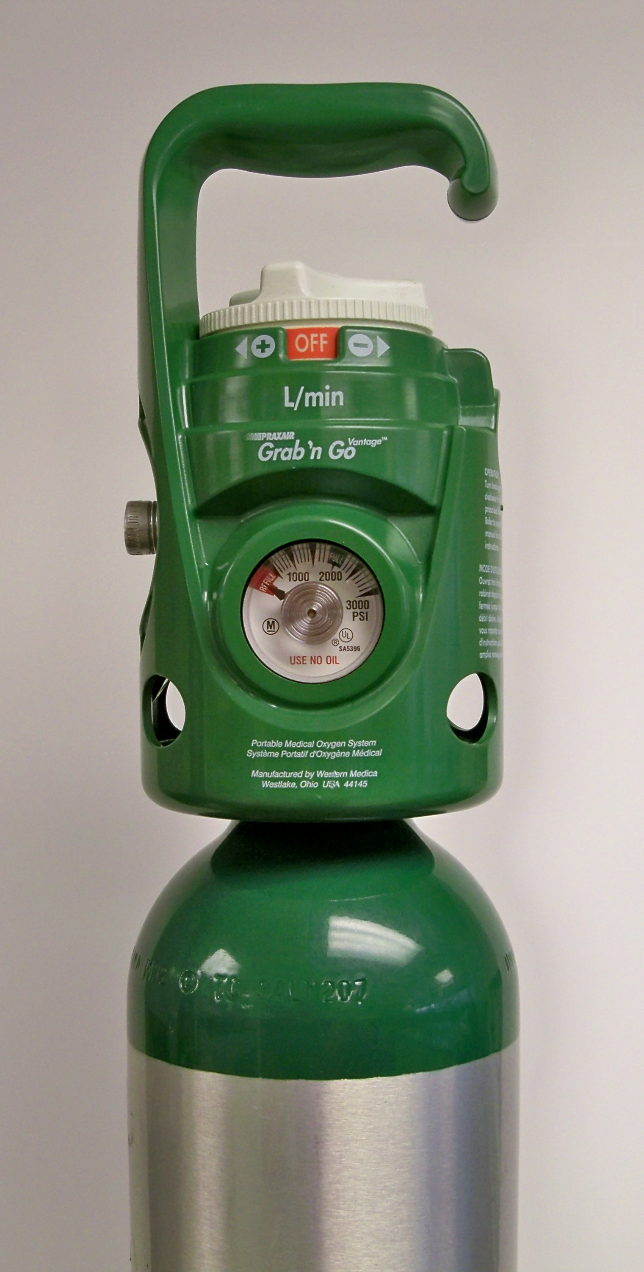
E-cylinders
Approximately 2 feet long and 4 inches in diameter
Smaller than H sized cylinders
Usually placed at the back of the anesthesia machine
Routinely used as a portable oxygen source
This Photo by Unknown author is licensed under CC BY-SA.

Slide 18
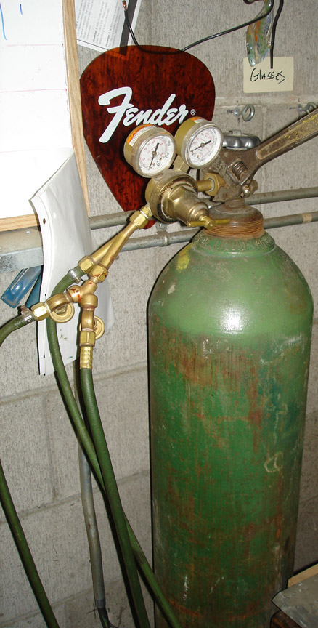
H-cylinders
Larger, 4 feet long and 4 inch in diameter
Used as a source of gas and also used in the pipeline system
May be used as an intermediate or long-term source of gas at the patient’s bedside
This Photo by Unknown author is licensed under CC BY-SA-NC.

Slide 19
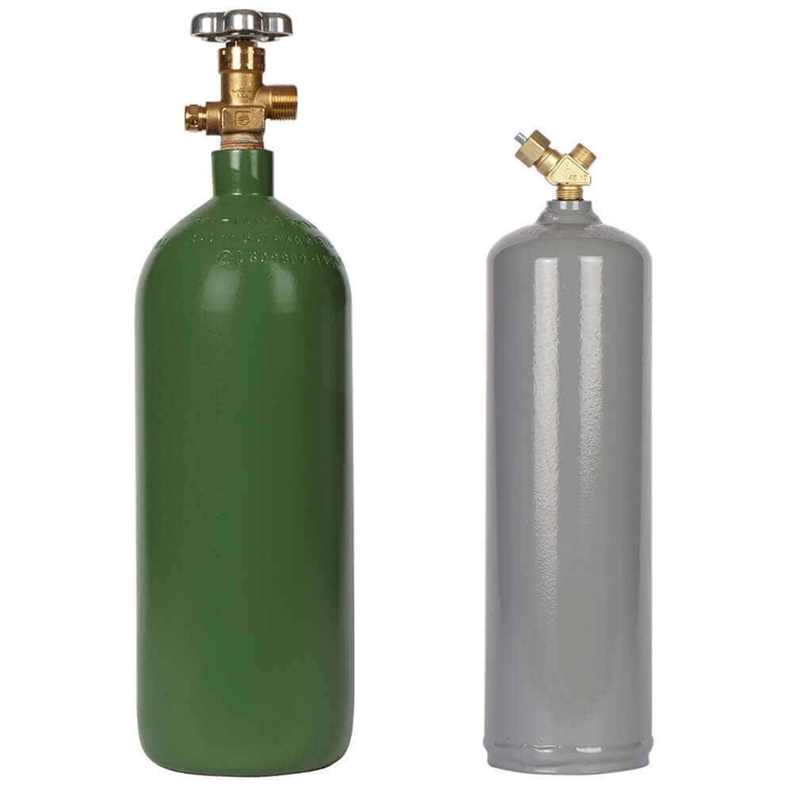
Parts of cylinder
Body
Most are constructed of steel
In recent years - steel carbon fiber cylinders - hold more gas and are lighter.
Cylinders made from aluminum have become available (MRI).
Have flat or concave bottoms.
The other end (neck) that is fitted with screw threads for attachment of the cylinder valve.

Slide 20
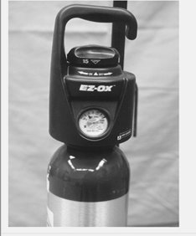
Cylinders with integral pressure regulators and flow-metering devices as well as handles.
Eliminates the need for pressure regulator, maintenance by the health care facility and simplifies use.

Slide 21
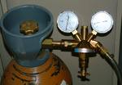
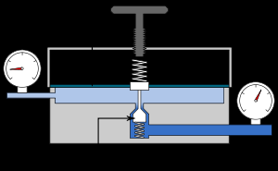
How is the pressure reduced?
Pressure reduction valves:
These supply gases to the anaesthetic machine at about 4 Bar (or 400 kPa)
Low Pressure Out
High Pressure in

Slide 22
Cylinders with integral pressure regulators and flow-metering devices as well as handles.
Eliminates the need for pressure regulator, maintenance by the health care facility and simplifies use.

Slide 23
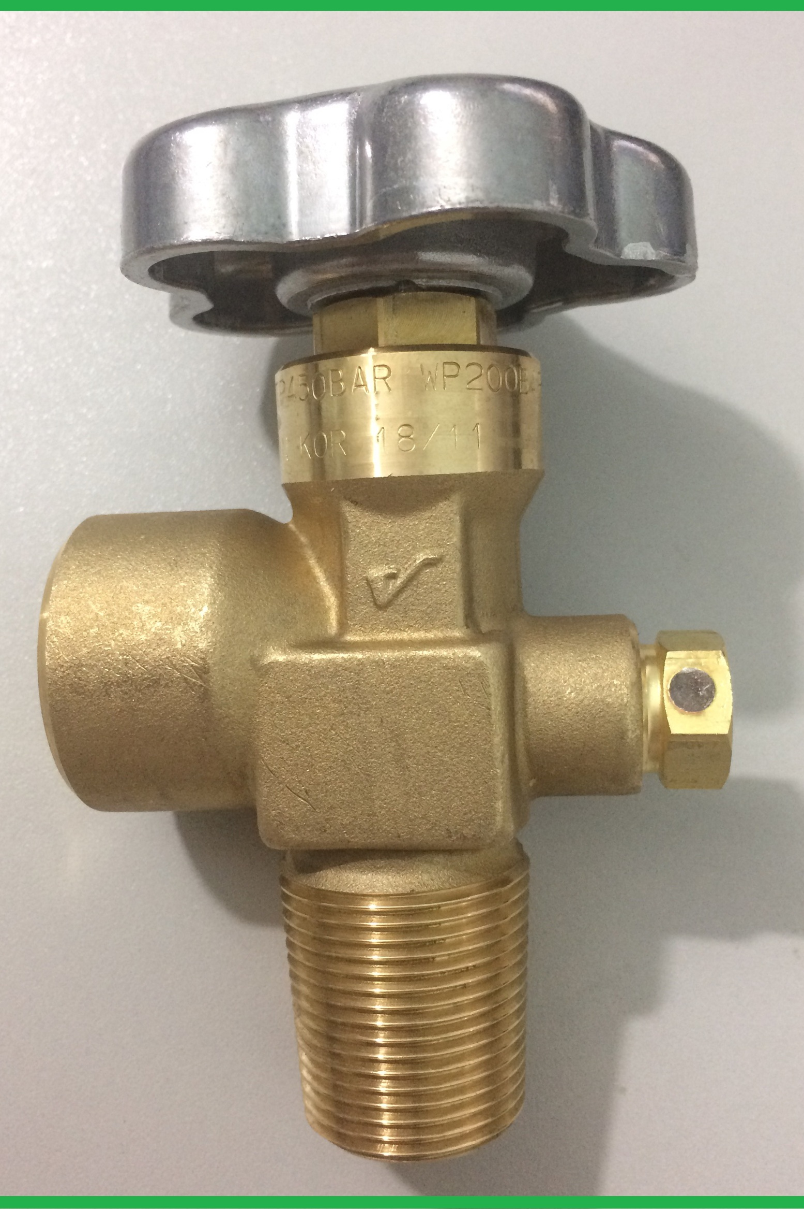
Cylinder valve
Cylinders are filled and discharged through valve,
Made of bronze or brass,
Should be removed only by the cylinder owner.

Slide 24
Port
It is the point of exit for the gas.
It should be protected in transit by a covering.
Important not to mistake the port for the conical depression on the opposite side of the valve.
Screw into the port may damage the port.

Slide 25
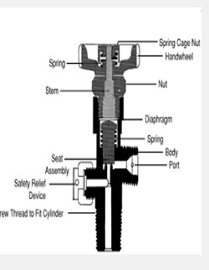
Stem
Each valve contains a stem, or shaft, that is rotated during valve opening or closing.
To close the valve, the stem seals against the seat.
When the valve is opened, the stem moves upward, allowing gas to flow out.

Slide 26
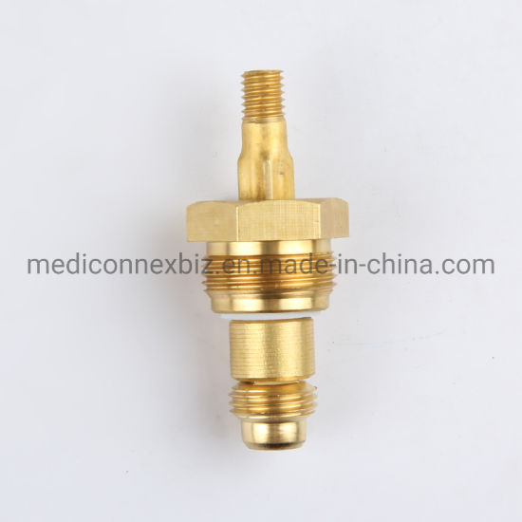
Stem
Each valve contains a stem, or shaft, that is rotated during valve opening or closing.

Slide 27

Diaphragm valve
Diaphragm separates steam from the seat.
Turning the stem raises or lowers the diaphragm.
Turning the stem clockwise lowers the diaphragm which in turn, lowers the seat and closes the valve.
Inverse during counter.

Slide 28
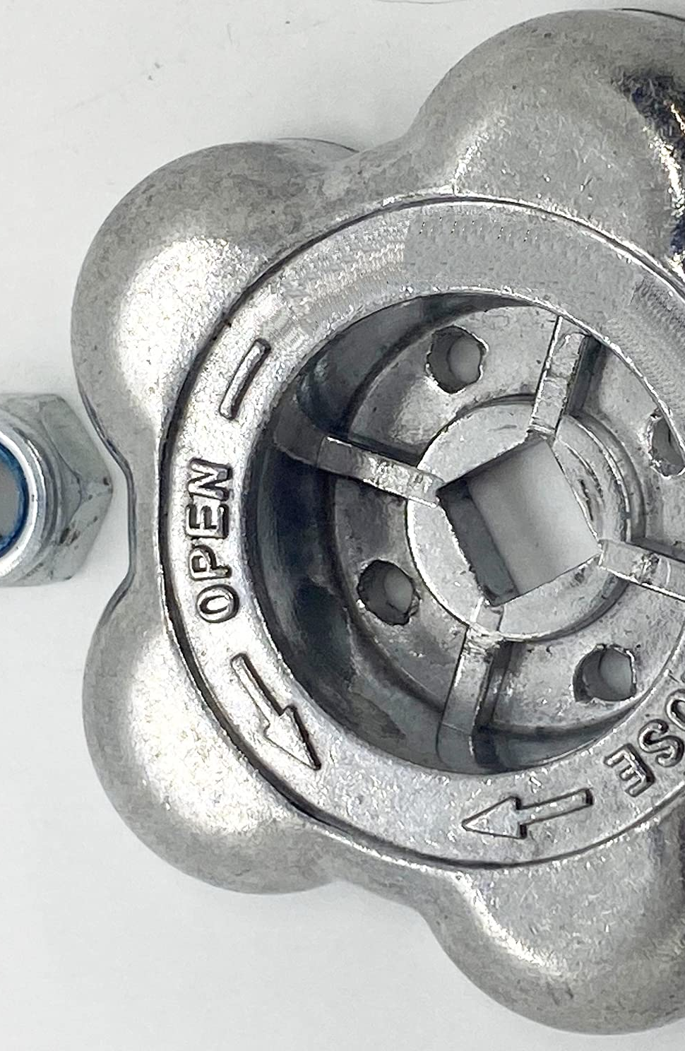
Handle or hand wheel
A handle or hand wheel used to open and close a cylinder valve.
Counterclockwise to open.
Unacquainted with cylinders could loosen the packing nut under the mistaken impression that he or she was opening the valve.
This could cause the valve stem and retaining nut to come off the cylinder with great force

Slide 29
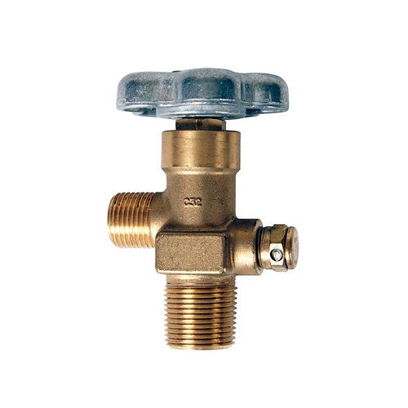
Pressure/Safety relief device
Is a spring-loaded device designed to reclose and prevent cylinder contents from being discharged after a normal pressure has been restored.
The set pressure, at which it will start to discharge, is marked on the valve.
The purpose is to vent the cylinder's contents to atmosphere if the pressure of the enclosed gas increases to a dangerous level.
More susceptible to leaks than rupture discs or fusible plugs.

Slide 30
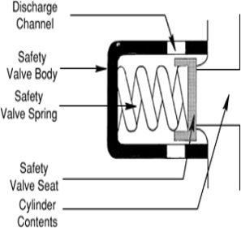
Handle or hand wheel
When the set pressure is exceeded, the pressure in the cylinder forces the spring to the left, and gas flows around the safety valve seat to the discharge channel.

Slide 31
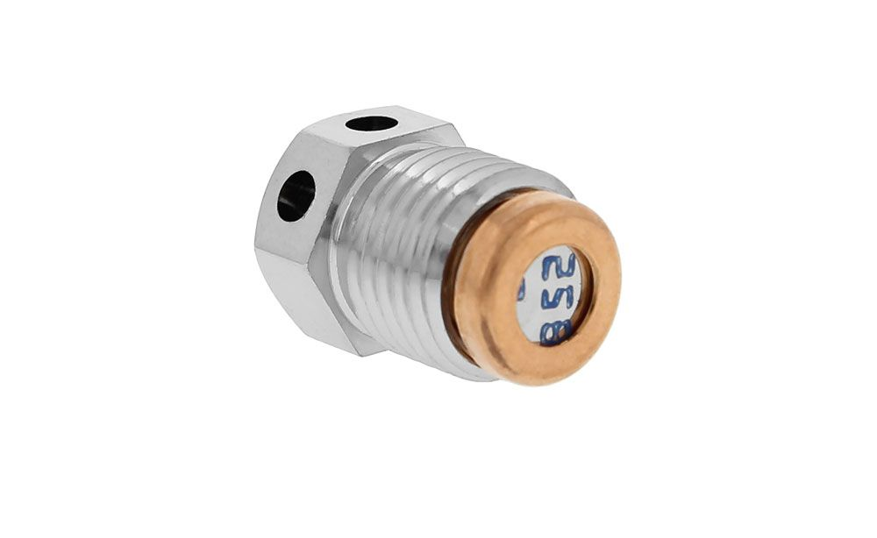
Rupture (frangible, burst) disc
When the predetermined pressure is reached, the disc ruptures and allows the cylinder contents to be discharged.
Protects against excess pressure as a result of high temperature or overfilling.

Slide 32
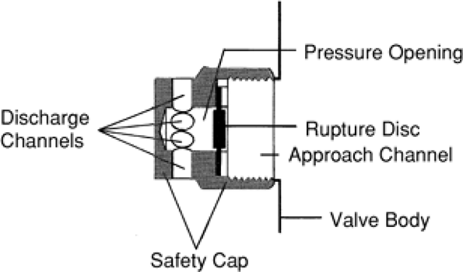
Cont’d
When the rated burst pressure is exceeded, the disc ruptures and gas flows from the approach channel into the pressure opening and to atmosphere through the discharge channels.

Slide 33
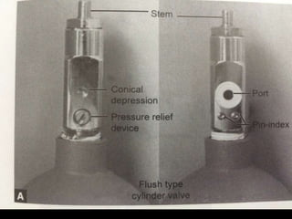
Conical depression
Found above the safety relief device on small cylinders.
Receives the retaining screw of the yoke.
Must be distinguished from the safety relief device.
If the retaining screw is tightened into the safety relief device, the device may be damaged and the cylinder contents escape

Slide 34
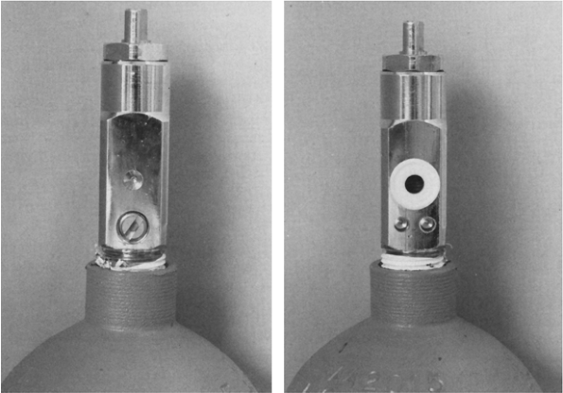
Left: - The conical depression is above the pressure relief device.
Right: - The port is above the Pin Index Safety System holes.

Slide 35
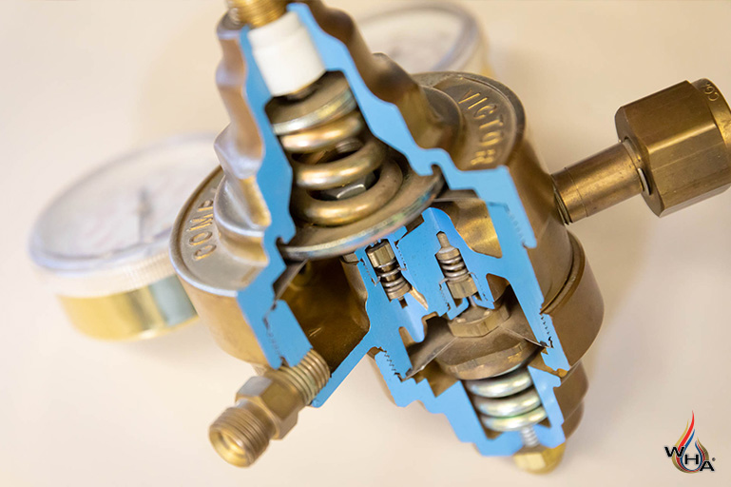
Pin index safety system
In the past, cylinders containing the wrong gas—for example, nitrous oxide instead of oxygen—were sometimes connected to anesthesia gas delivery systems, with disastrous results. This led to the development of systems designed to help ensure use of the correct cylinder.
pin index safety system was developed in 1952 for the E cylinder types

Slide 36
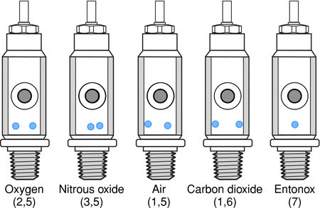
The pin index system relies on two 5-mm stainless steel pins on the cylinder yoke connector just below the fitting for the valve outlet port.
Seven different pin positions are possible depending on the type of gas in the cylinder
Unless the pins and holes are aligned, the port will not seat

Slide 37
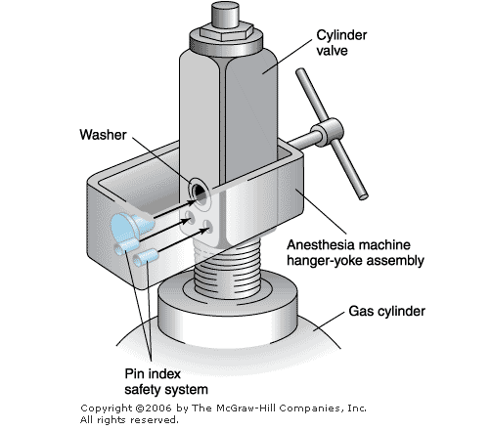

Slide 38
Cont’d
Pin index system works well for the common gases used in anesthesia.
There are problems when specialized gas mixtures are used.
As an example, a 5% CO2 mixture with oxygen has a different pin index than 100% carbon dioxide.
Carbon dioxide mixtures of 7% or greater CO2 would be fitted with the pin index of 100% CO2.

Slide 39
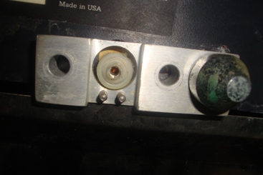
Cont’d

Slide 40
Size
Classified cylinders using a letter code
A begin the smallest
E is the cylinder most commonly used on anesthesia machines.
The volume and pressure of gas in a particular size cylinder vary.
O2 and air are similar in volumes and pressures.
True for CO2 and N2O.
Cylinder size | Capacity | Pressure/psig
B | 200 | 1900
D | 400 | 1900
E | 660 | 1900
M | 3450 | 2200
H | 6900 | 2200

Slide 41
Contents and pressure
In cylinder containing a non liquefied gas the pressure declines steadily as the contents are withdrawn, therefore, the pressure can be used to measure the cylinder contents.
In cylinder containing a liquefied gas, the pressure depends on the vapor pressure of the liquid and is not an indication of the amount of gas remaining in the cylinder as long as the contents are partly in the liquid phase.

Slide 42
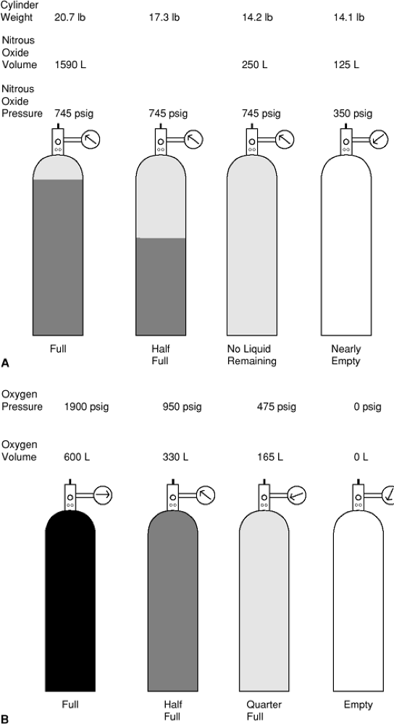

Slide 43
Cont’d
A: A gas stored partially in liquid form, such as nitrous oxide, will show a constant pressure (assuming constant temperature) until all the liquid has evaporated, at which time the pressure will drop in direct proportion to the rate at which gas is withdrawn.
B: A nonliquefied gas such as oxygen will show a steady decline in pressure until the cylinder is evacuated. Each cylinder, however, will show a steady decline in weight as gas is discharged.

Slide 44
Testing
A cylinder must be inspected and subjected to internal hydrostatic pressure testing at least every 5 years or with special permit up to every 10 years.
The test (month and year) must be permanently stamped.
A cylinder that leaks or expands more than the allowable limit must be rejected.

Slide 45

Color
Used as a means to aid in identifying gases in use.
The top and shoulder of each cylinder are painted the color assigned to the gas it contains.
An international color code has been adopted.
Is useful to identify the contents of a cylinder from a distance.

Slide 46
Color cont.
Color should be not be used as the primary means for identification of cylinder contents.
Cylinder labels are the best method.
Gas | International
O2 | White
CO2 | Gray
N2O | Blue
He | Brown
N2 | Black
Air | White & black

Slide 47
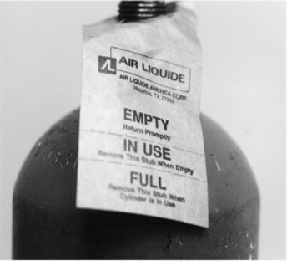
Tags
It has three sections
EMPTY,
IN USE, and
FULL
When a cylinder is put into service, the FULL portion of the tag should be detached. When the cylinder is empty, the IN USE portion should be removed, leaving the EMPTY label.
Primarily a means of denoting the amount of cylinder contents, not an identification device.

Slide 48
Notes:
2. They may contain combustible material

Slide 49
General rules for safe use of cylinders
Should be handled only by trained personnel.
Valves, pressure regulators, gauges, or fittings should never come in contact with oils, greases, organic lubricants, rubber.
No part of any cylinder should ever be subjected to a temperature above 54°C (130°F) or below -7°C (20°F).
Connections to d/t equipments should always be kept tight to prevent leaks.
Pressure relief device or the valve outlet must not be obstructed.

Slide 50
General rules for safe use of cylinders
6. 6. Adapters to change the outlet size of a cylinder valve should not be used.
7. The valve should be kept closed at all times except when the cylinder is in use.
8. No part of the cylinder or its valve should be tampered with, painted, altered, repaired, or modified by the user.
9. Markings, labels, or tags must not be defaced, altered, or removed.
10. A cylinder should not be used as a roller, support, or for any other purpose.

Slide 51
General rules for safe use of cylinders
6. 6. Adapters to change the outlet size of a cylinder valve should not be used.
7. The valve should be kept closed at all times except when the cylinder is in use.
8. No part of the cylinder or its valve should be tampered with, painted, altered, repaired, or modified by the user.
9. Markings, labels, or tags must not be defaced, altered, or removed.
10. A cylinder should not be used as a roller, support, or for any other purpose.

Slide 52
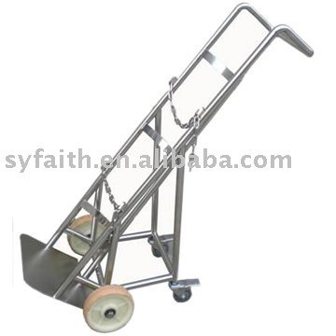
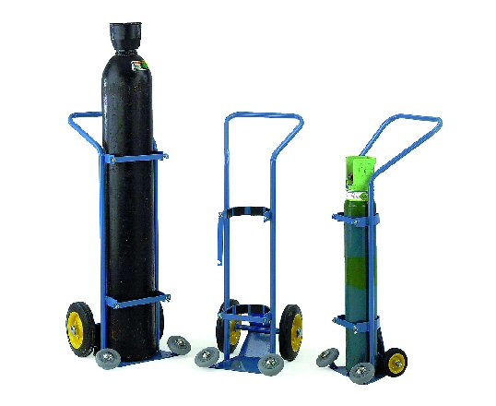
Cont’d
11. Cylinders not be placed or used in a manner where they can become part of an electrical circuit.
Cylinders should not be dropped, dragged, slid, or rolled, even for short distances.

Slide 53
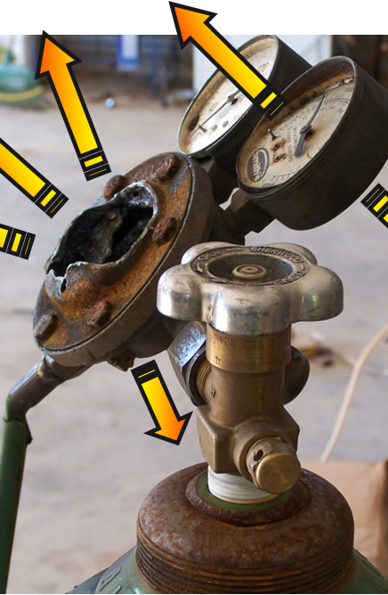
General rules for safe use of cylinders
12. The owner of the cylinder must be notified if any damage is noticed.
13.Disposition of unserviceable cylinders should be done only by qualified personnel.
14. Cylinders should be properly secured at all times to prevent them from falling or being knocked over.

Slide 54
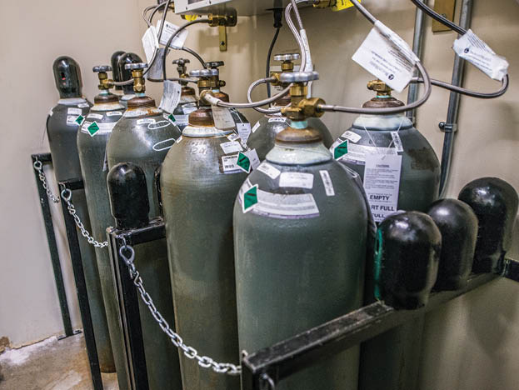
storage
A definite area should be designated (Not OR).
The storage area should be in a cool, dry clean, well-ventilated room that is constructed of fire-resistant material.
Easily visible signs with texts such as:-
“GAS CYLINDERS”
“REMOVE TO A SAFE PLACE IN THE EVENT OF FIRE”
“OFF LIMITS TO UNAUTHORIZED PERSONNEL”
“NO SMOKING,”
“NO OPEN FLAMES OR SPARKS,”
“NO OIL OR GREASE,” and
“NO COMBUSTIBLE MATERIALS”

Slide 55
storage
Should be protected against extremes of weather.
Cylinders should be stored in a secure area.
Combustible materials should not be kept near cylinders (with rare exceptions).
Cylinders should be protected from mechanical shock.
Small cylinders are best stored upright or horizontally while Large cylinders should be stored upright against a wall and chained in place.
There should be a system of inventory for both empty and full cylinders.

Slide 56
storage
Should be protected against extremes of weather.
Cylinders should be stored in a secure area.
Combustible materials should not be kept near cylinders (with rare exceptions).
Cylinders should be protected from mechanical shock.
Small cylinders are best stored upright or horizontally while Large cylinders should be stored upright against a wall and chained in place.
There should be a system of inventory for both empty and full cylinders.

Slide 57
During use
Before use the content of the cylinder should be identified.
A pressure regulator should always be used.
Before a regulator is connected to a cylinder, it should be inspected for signs of damage and FB.
Before any fitting apply slow and brief opening (“cracking”) of the valve.
Protection cap should be removed just before connecting.
Connectors that do not fit should never be forced.

Slide 58
Cont’d
The person opening a cylinder valve should position himself or herself… & goggles.
A cylinder valve should always be opened SLOWLY ?
After the cylinder valve is opened, the pressure should be checked.
Cylinder must be secured to a cylinder stand or to apparatus of sufficient size to render the entire assembly stable.
The valve should always be fully open when a cylinder is in use.

Slide 59
After use
Valve should be closed.
An empty or near-empty cylinder should not be left on an anesthesia machine.
Before removing a cylinder the valve should be closed and all downstream pressure released.
Valves should be completely closed on all empty cylinders.
Valve protection caps should be replaced before shipment.

Slide 60
Hazards
Incorrect cylinder - pins
Incorrect content – wrong & not mixed
Incorrect valve
Incorrect color
Incorrect labeling
Inoperable/ Damaged Valve
Projectile damage
Blocked flow meter
Fires,
Explosion

Slide 61
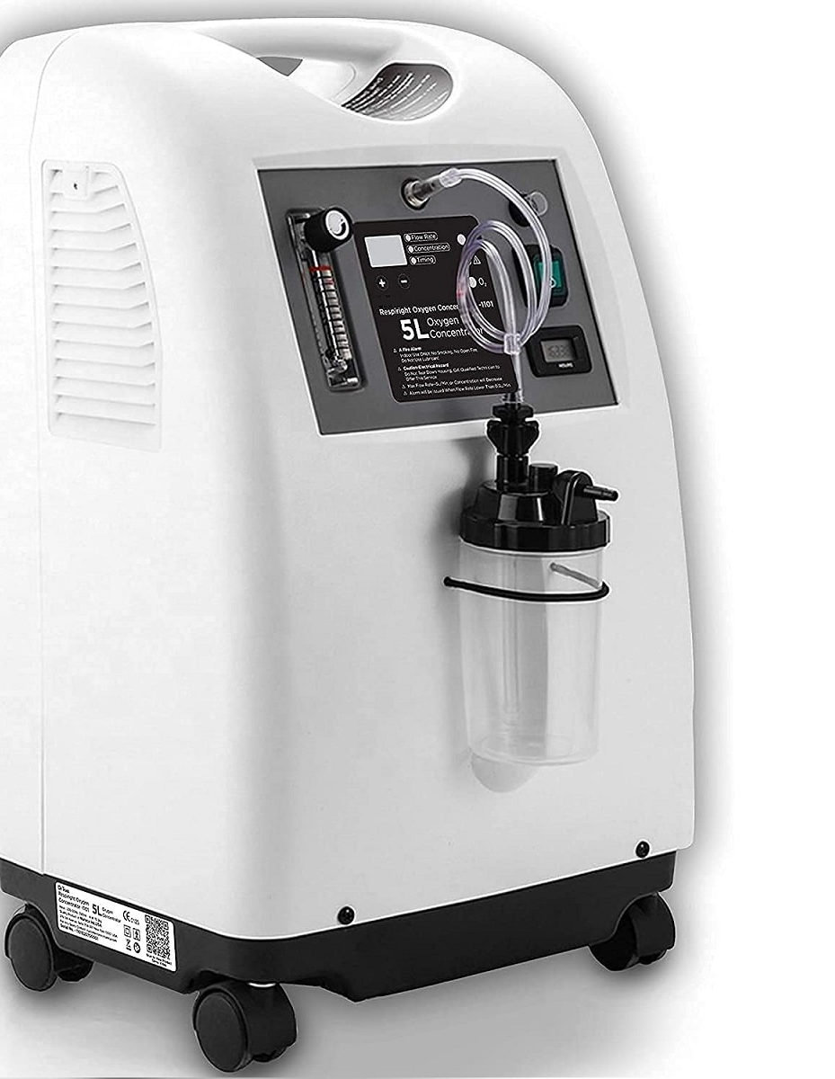
Oxygen concentrators

Slide 62
Oxygen concentrators
Oxygen is generated by the selective adsorption of the components of air with molecular sieve technology.
Most concentrators use an inorganic silicate belonging to a class of crystalline compounds known as zeolites for the molecular sieve
Air is forced through the sieves under pressure, and oxygen and nitrogen are generated.

Slide 63
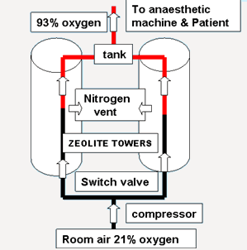
Mechanism
The oxygen is then used clinically, and the nitrogen is vented to the atmosphere.
The maximum oxygen concentration produced by concentrators is approximately 90% to 96%, with the balance made up mostly of argon

Slide 64
Advantages
Cost Savings decreases
Contaminant Filtration
Compatibility with Most Gas Monitors
Reliability – not affected by altitude changes
Simplicity

Slide 65
Disadvantages
Maintenance – filter change
Less Than 100% Oxygen Produced
Fires Hazards – overheated, tube rub…
Water Contamination – very high humidity decreases o2 concentration
Contaminated Intake Air – premature exhaustion
Device Malfunction – restricted flow to it, kink, run but no o2
Argon Accumulation – max 5%, problem if 0.5L/m, no patient effect

Slide 66
Anesthesia Equipments
Medical Gas supply √
Anaesthetic machine
Breathing systems
Humidification and filtration
Airways
Tracheal intubation equipment
Masks and oxygen delivery devices
Ventilators

Slide 67


